Slide 1
Discussion: Reference genome testing

Slide 2
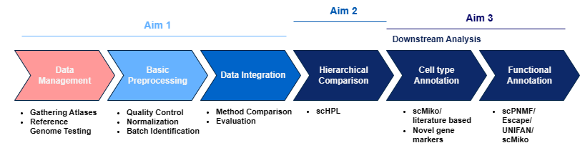
Recap
Goal: Integrate multiple scrna atlases of VTA to have a higher resolution analysis.
Different reference genomes and software versions for alignment
Test if data is still comparable

Slide 3
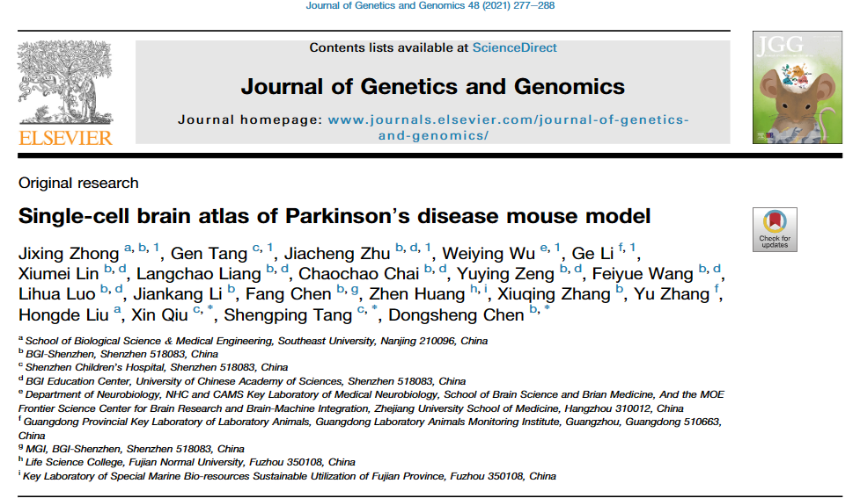
Reference Genome Testing
The data
~5.5k healthy midbrain cells
Reference genomes:
Ensemble 93 (2018) vs Ensemble 98 (2020)
Cell Ranger v3.0 vs Cell Ranger v6.1
Zhong, J. et al. (2021). Single-Cell Brain Atlas of Parkinson's Disease Mouse model. Journal of Genetics and Genomics,
“Interpreting Intronic and Antisense Reads in 10x Genomics Single Cell Gene Expression Data”, 10X Genomics

Slide 4
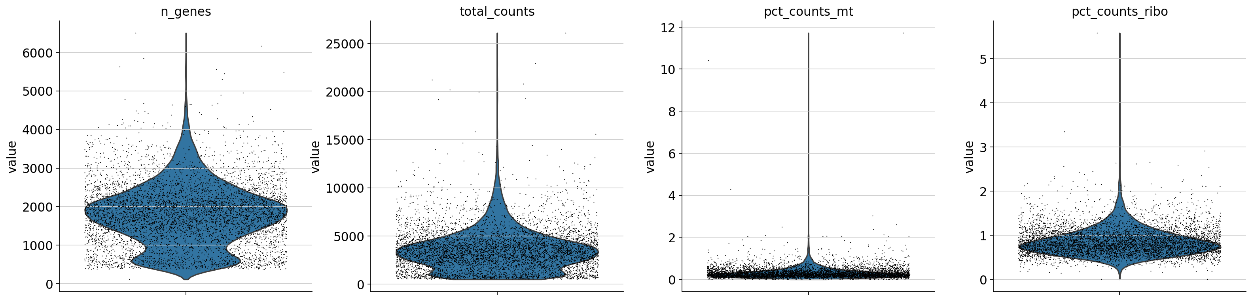
Reference Genome Testing - Quality Control
# unique genes/# counts per cell: filter ambient rna
Proportion mitochondrial and ribosomal counts: dying cells
#Cells per gene: minimal 3 cells per gene

Slide 5
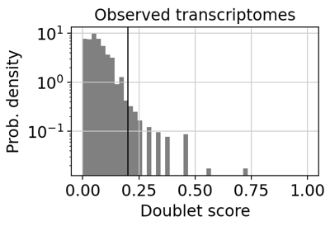
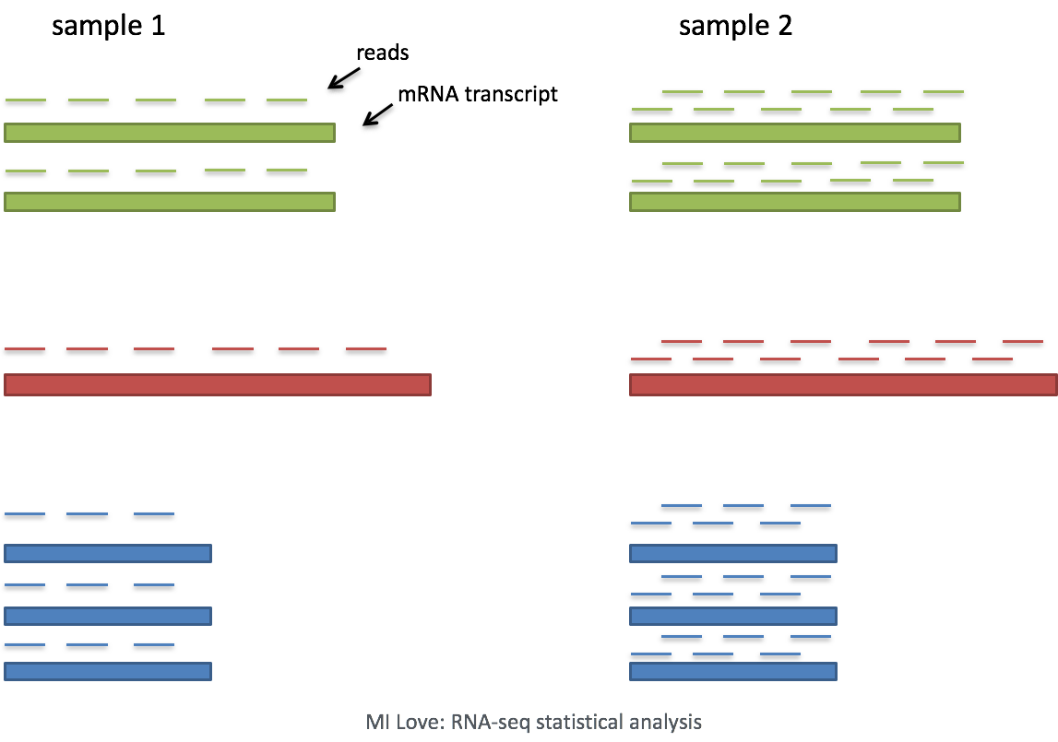
Reference Genome Testing – QC/Normalization
Doublet detection with Scrublet
Normalization
Sequencing depth: some cells get sequences more by chance
https://hbctraining.github.io/scRNA-seq_online/lessons/06_SC_SCT_normalization.html

Slide 6
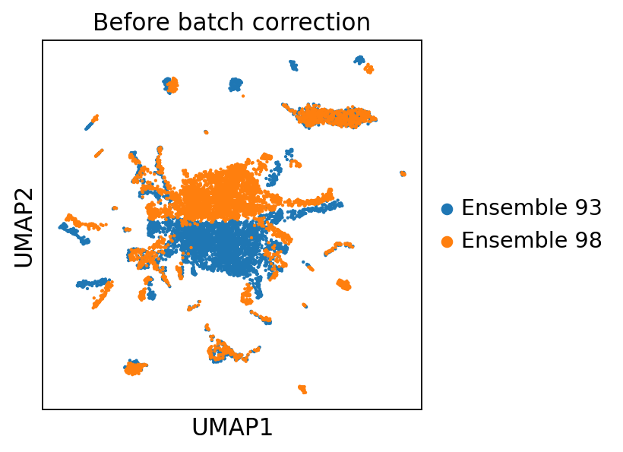
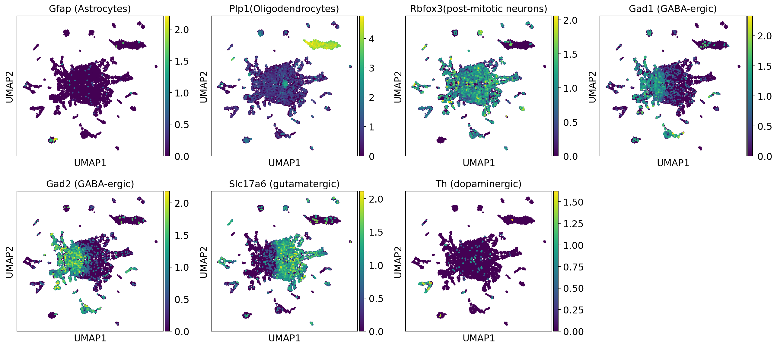
Reference Genome Testing – Merging and Clustering
Marker genes

Slide 7
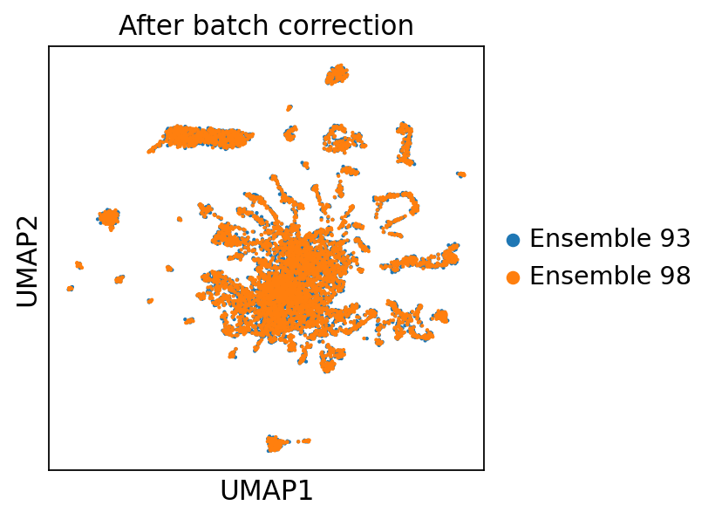
BUT….
Looks like batch effect, but isn’t that what we want?
Processing is an iterative process, need to do more tests!

Slide 8
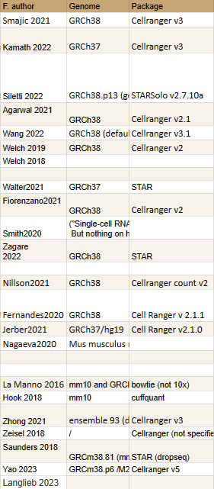
Discussion
Why filter on high proportion of ribosomal RNA?
Almost no atlas aligned to intronic regions

Slide 9
Acknowledgements
Onur Basak
Tiziana Hey
Abdool Al-Khaledi
Cecile Herbermann
Basak Lab

